Slide 1

CIS – 1150 Business Communications
Presentation Assignment

Slide 2


Pranks, Mischief, and Shenanigans

Slide 3
Learning the Ways
A presentation on the importance of learning Malware design and development.

Slide 4
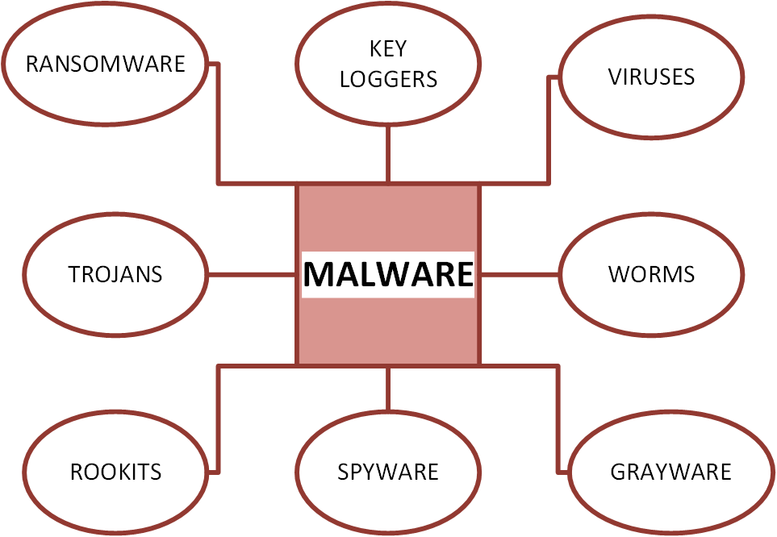
Malware Types

Slide 5
Malware Specific Examples
Stuxnet – Worm
Zeus Keystroke Logger - Keylogger
Shellbash / Bashdoor - Backdoor

Slide 6

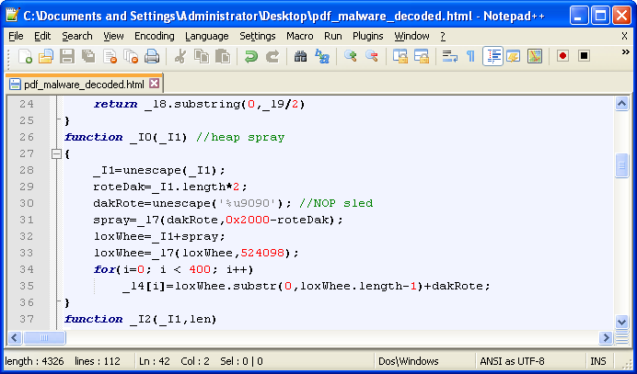
Malware Code

Slide 7

Teaching Malware

Slide 8


Analogies for Learning Malware

Slide 9
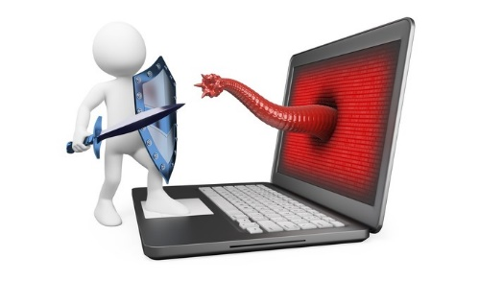
In Conlusion…

Slide 10
References
Ledin, George Jr. (2011). The growing harm of not teaching malware. Communications of the ACM, 54(2), 32-34.
Computer Frustrated Image (Slide 2)
http://www.freemake.com/blog/wp-content/uploads/2014/03/computer_-_cursing.gif.jpg
Nelson Haha Image (Slide 2)
http://img2.wikia.nocookie.net/__cb20130818100405/survivoronlinegaming/images/9/96/Simpsons-nelson-ha-ha-93-p-672x480.jpg
Red Malware Image (Slide 6)
http://blog.kaspersky.com/files/2012/10/malware-bytes.jpg
Malware Code in Editor (Slide 6)
https://blog.malwarebytes.org/intelligence/2013/08/the-malware-archives-pdf-files/

Slide 11
References ( Cont’d )
Teaching Malware Picture (Slide 7)
http://www.ucl.ac.uk/teaching-learning/images/520x200/teacher_two_students.jpg
Microscope (Slide 8)
http://ak.picdn.net/shutterstock/videos/4498304/preview/stock-footage-medical-researcher-using-microscope.jpg
Surgery Picture (Slide 8)
http://www.comtecmed.com/Uploads/assets/doctors_1.jpg
Virus vs Antivirus (Slide 9)
http://tpucdn.com/npu/img/2013/09-21/3773-a67ac056_680_400.jpg

